Slide 1



DevOps PoT - Architecture

Slide 2
Application Types
Java (Monolithic or Microservice based)
.Net Core (Microservice based – Recommended for newer applications)
.Net Framework (Monolithic – Existing applications)

Slide 3
Architecture Considerations
Source Code Management
Developer IDE
DevOps (CI-CD) Pipeline
Container
Container Orchestration
Monitoring
Logging
Service Discovery
Storage Management
Application Integration

Slide 4
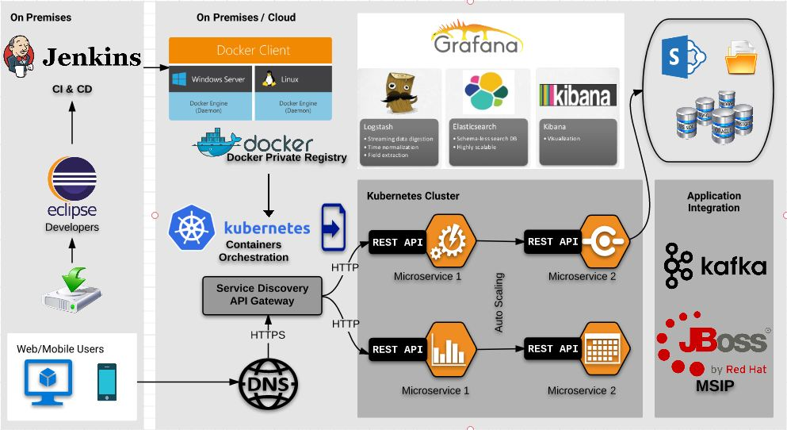
Reference Architecture - Java

Slide 5
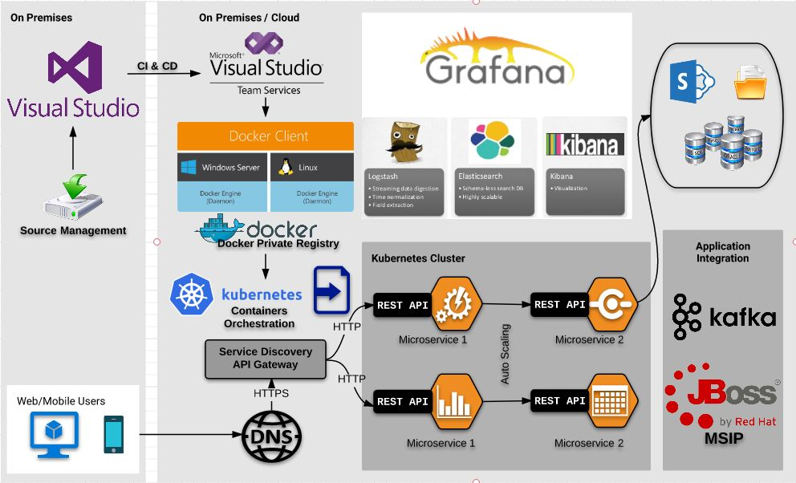
Reference Architecture - .Net Core

Slide 6
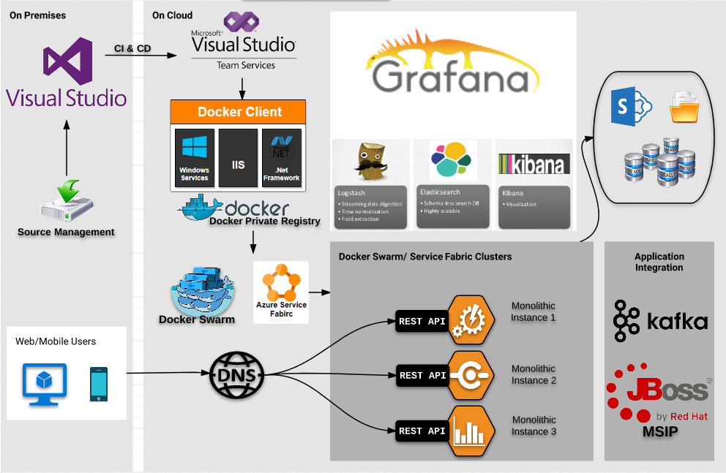
Reference Architecture - .Net Framework

